Slide 1
Visitor pattern

Slide 2
Topics
What is the visitor pattern
Where is it found
How to use it
When to use it

Slide 3
Pattern: Visitor
It’s job description:
Make it possible for us to work with collections of different types of objects and do type-specific operations in a type-safe way.
This allows us to interesting things with classes without modifying them

Slide 4
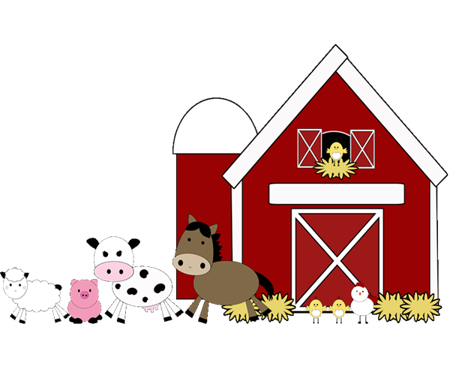
The problem
Let’s say I have a farm
It has
Cattle
Chickens
Llamas
Pigs
Let’s say a farmer is just a class that holds all the animals

Slide 5
The problem
Often time we want statistics
Suppose I want to know…
How many chickens I have?
Total milk production per day?
How many animals have not been vaccinated?
How many females/males of each type?

Slide 6
The problem
A naive solution without this pattern would probably look like this:
Base class:
Derived classes
All of the above…again
Animal
isChicken() : bool getMilk() : float isMale() : bool getEggs() : int etc

Slide 7
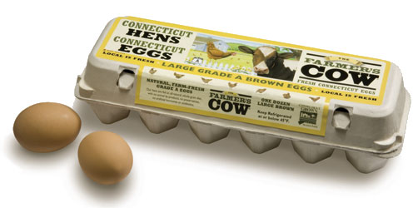
The problem
Every time I want to ask a new question, I have to modify all of the classes to answer it.
This is bad for flexibility and extendibility and you answer the question in a lot of places.
Not only a lot of work, but why on Earth are we asking a cow how many eggs they laid?!
What SOLID principles does this violate?

Slide 8

Let start with one task
We want to ask the farmer how many male animals he has.
Here’s the problem, though. Our farmer (class) only knows he has animals, not what type of animal they are.

Slide 9
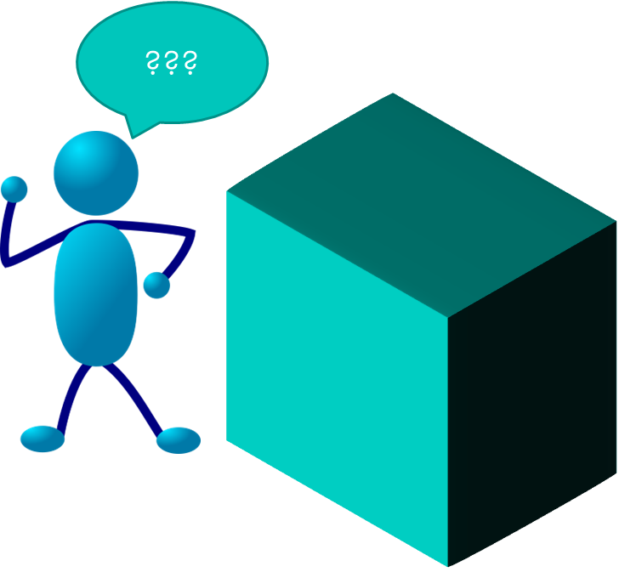
Let start with one task
Think of it as if the farmer can only know he has opaque boxes, each with an animal in it.
We need to create a way that our animals can tell the farmer they are male through the box.

Slide 10
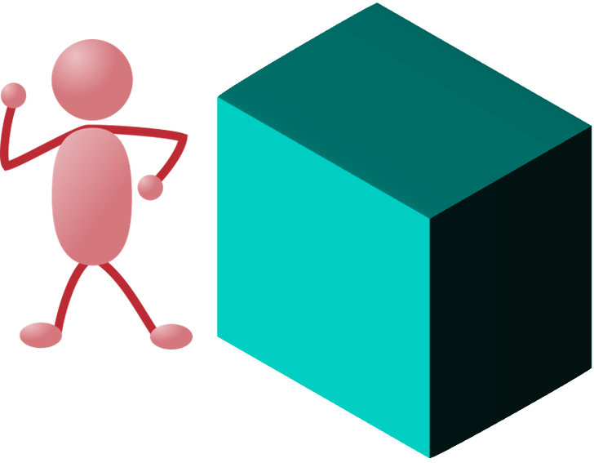
Let start with one task
We have a special employee (class) called a visitor. She has the ability to go into the box and have the actual animal talk to her.
Moo?

Slide 11

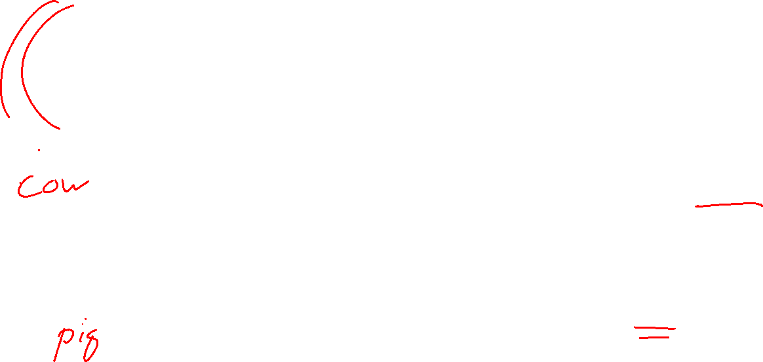
Special access (start here)
Our visitor will be an instance of the Visitor class. We’ll pass it to the box.
An overridden function will pass it to the actual animal, who will call a function specific to that animal type. Suddenly, our visitor knows the animal’s type (and more!).
Moo?
Oink?

Slide 12

Special access
This much passing around can be confusing. Let’s walk through this one class/function at a time.

Slide 13
Here is how it works in code
1) We make an interface that ALL animals can accept (yay, polymorphism!)
Call this Visitor:
<<Interface>> Visitor

Slide 14

Here is how it works in code
1b) A Visitor interface needs a function for EACH type it cares about
In this case, all of our animals
<<Interface>> Visitor
AcceptCattle(c: Cattle) AcceptChicken(c: Chicken) …

Slide 15
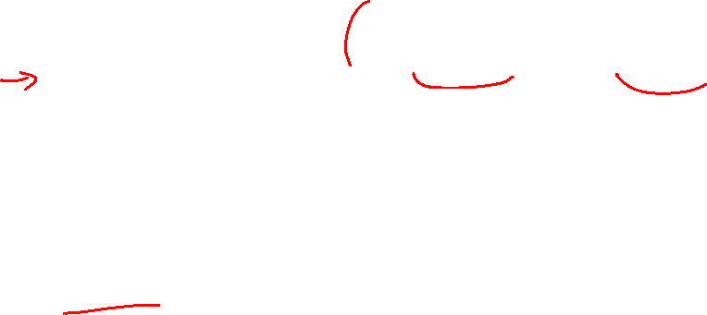
Add acceptance
2) Add the function to accept the visitor
To ensure ALL animals have this, make it abstract
…or virtual
…or whatever the language syntax needs
…of even default behavior! (less common)
<<Interface>> Visitor
…
Base class
ABSTRACT accept(v : Visitor)

Slide 16
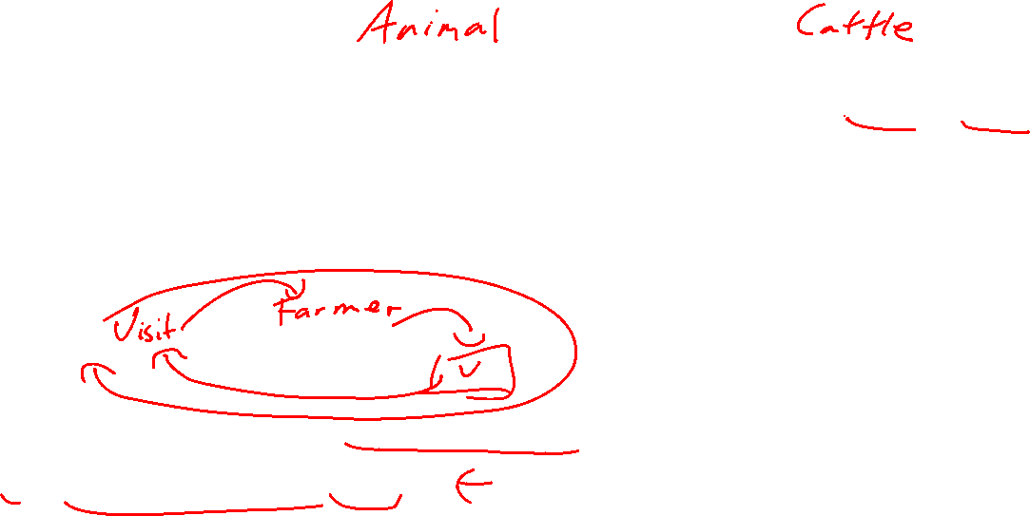
Add acceptance
3) Add the function to accept the visitor
Override the accept in each derived class, such that is calls the visitor function that matches. For example, Cattle would have:
override accept (v : Visitor )
v.AcceptCattle(this);
<<Interface>> Visitor
…
Base class
ABSTRACT accept(v : Visitor)
Concrete class
override accept(v : Visitor)

Slide 17
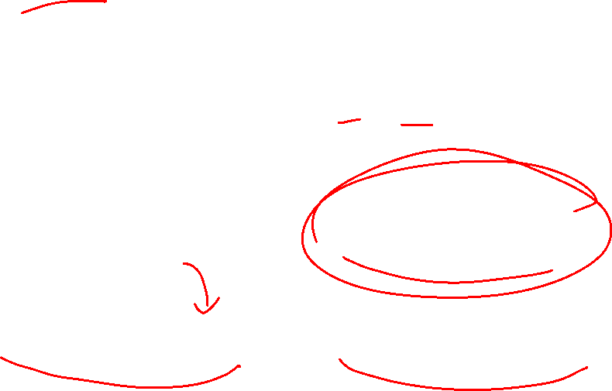
Make a new visitor
4) Now make the concrete visitor class
Make a new class that implements the interface
Let’s call this CountMalesVisitor
<<Interface>> Visitor
…
CountMalesVisitor
…
Animal
ABSTRACT accept(v : Visitor)
Chicken
override accept(v : Visitor)

Slide 18
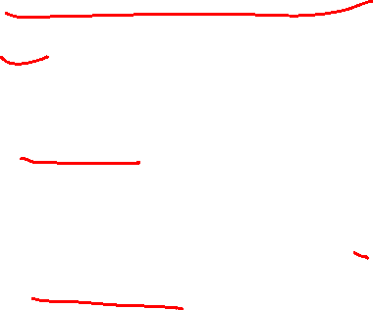
Make a new visitor
4b) Inside, we can have it check according to type
E.g. (in pseudocode)
class CountMalesVisitor
cnt = 0
AcceptCattle(Cattle c)
If c.isBull()
Cnt++
AcceptChicken(Chicken c)
If c.isRooster()
Cnt++

Slide 19
Use it!
5) Call it
For each animal of interest, the farmer calls animal[i].accept(v)(or equivalent) This passes the visitor into the “box”.

Slide 20
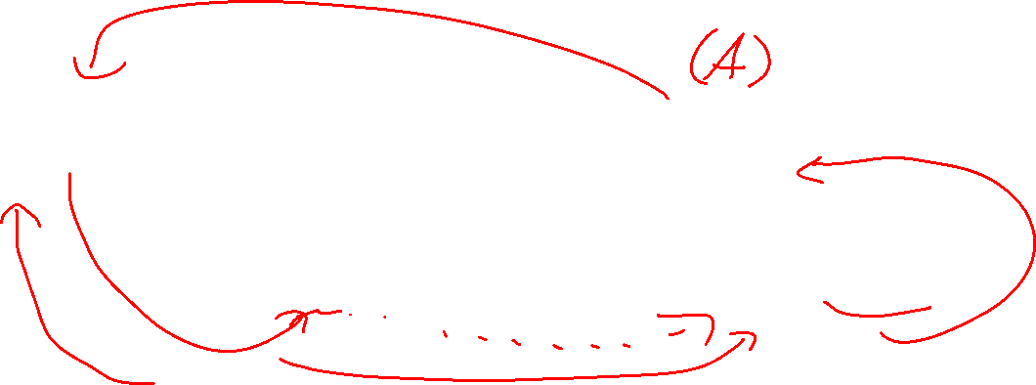
Don’t forget the collection!
Technically, this is all that is strictly needed for the pattern, but 95%+ of the time, we need a collection to start the process.
runTask() will make a visitor inside.
<<Interface>> Visitor
…
CountMalesVisitor
…
Farmer
runTask(): void
Animal
ABSTRACT accept(v : Visitor)
Chicken
override accept(v : Visitor)
*

Slide 21
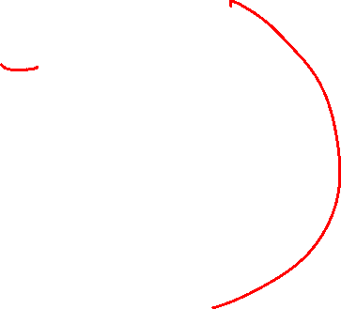
Don’t forget the collection!
The most common use case is this (this is in Farmer, our manager class):
void accept(Visitor v){
for( Animal a in Animals)
a.accept(v)
}

Slide 22
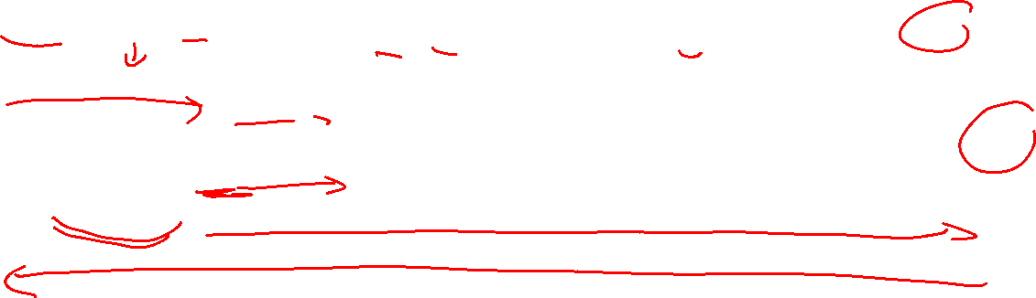
Use it!
Here is how it is passed around (cmv = instance of CountMaleVisitor)
Caller Farmer Animal[0] Animal[1] … cmv: CountMalesVisitor
f.accept(cmv)
List[0].accept(cmv)
cmv.AcceptA(this)
List[1].accept(cmv)
cmv.AcceptA(this)
cmv.getCount()
cnt

Slide 23
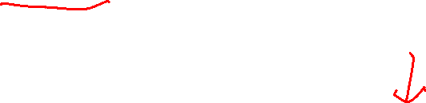
Side note:
Where did the association go here?
Visitors are often a “uses-a” relationship, so make a note on a diagram
<<Interface>> Visitor
…
CountMalesVisitor
…
Farmer
runTask(): void
Farmer uses the Visitor interface
Animal
ABSTRACT accept(v : Visitor)
Chicken
override accept(v : Visitor)
*

Slide 24
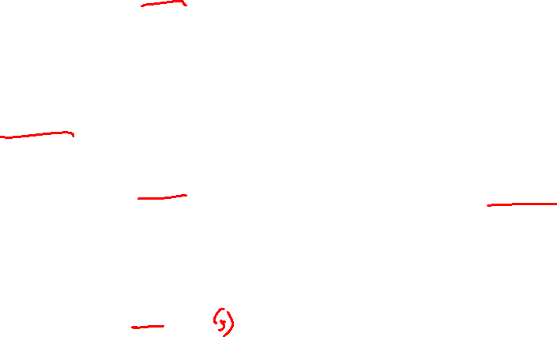
Recap on making a visitor
Create a visitor class with accept functions for every type of object we may visit.
In a superclass for every type of object we may visit, add an accept function.
In every derived class, provide an Accept function that calls the appropriate accept function.
In any class with a collection, create a function that access the desired element in the collection, calling accept on each object.
Note, this is most commonly a for-each loop, but adjacent elements is also very common

Slide 25
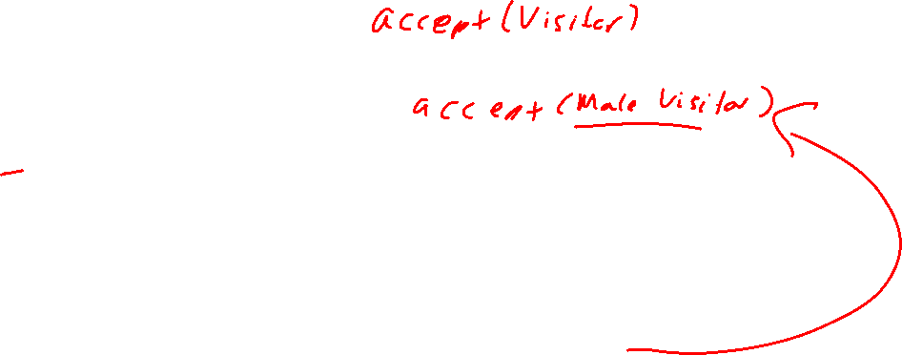
Implementation notes
Common errors:
If there is a parameter in collection function that uses a specific type of Visitor and not the parent
You broke D in SOLID
If you have more than function looping through your collection for a visitor
You broke O in SOLID
Another function for a singular item, or range is OK
If you have a Visitor member variable in your collection
You broke O in SOLID

Slide 26
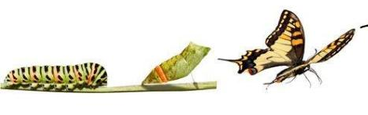
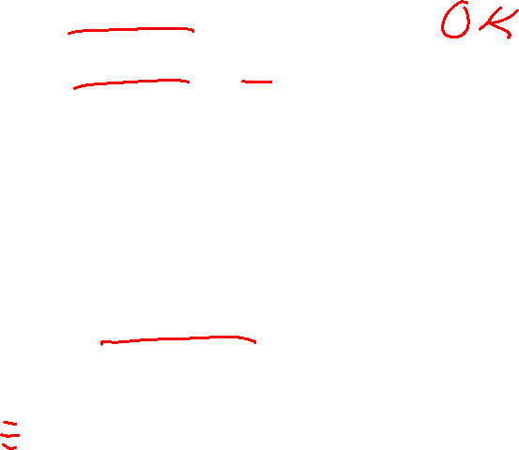
Example of errors 1\2
Call should be generic
accept(v:Visitor)
accept(v:Visitor, max: int)
The above are OK.
These are not:
accept(v:MaleVisitor)
//only looks at the first two accept2(v:Visitor)
How do you fix this?
Polymorphism!

Slide 27
Example solving error 3
Make the Visitor in the caller to avoid reopening The manager!
Hub makes the visitor instance, and forwards it to Farmer. It then uses the result stored in the visitor.
Hub
runTaskA(): void
<<Interface>> Visitor
…
CountMalesVisitor
…
Farmer
runVisitor(v : Visitor): void
?
Animal
ABSTRACT accept(v : Visitor)
Chicken
override accept(v : Visitor)
*

Slide 28
Don’t like acceptX()?
visitX() and ImAX() also can be used in place of accept()
Instead of accept(v:Visitor)
handle(v:Visitor)
sentAVisitor(v:Visitor)
welcomeVisitor(v:Visitor)
acceptOperation(v:Visitor)
performOperation(v:Visitor)
doJob(v:Visitor)
<<Interface>> Visitor
visitCattle(c: Cattle) ImAChicken(c: Chicken) …

Slide 29

Visitor
Advantage
Advantage
The amazing thing is that you can add new capabilities without changing the way the data is stored.
For a complex task, all of the code for the task ends up in one place instead of being spread all over.

Slide 30
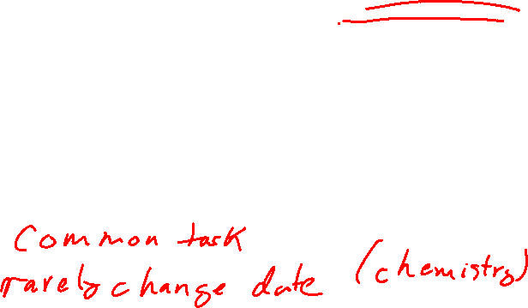
Visitor
Disadvantage
Disadvantage
There is a bit of extra code needed to support the visitor pattern.
The function name Accept() is not meaningful. The meaning is the concrete visitor.
Also, every time you add a new derived type, you have to add a new accept/visit function for that type.

Slide 31
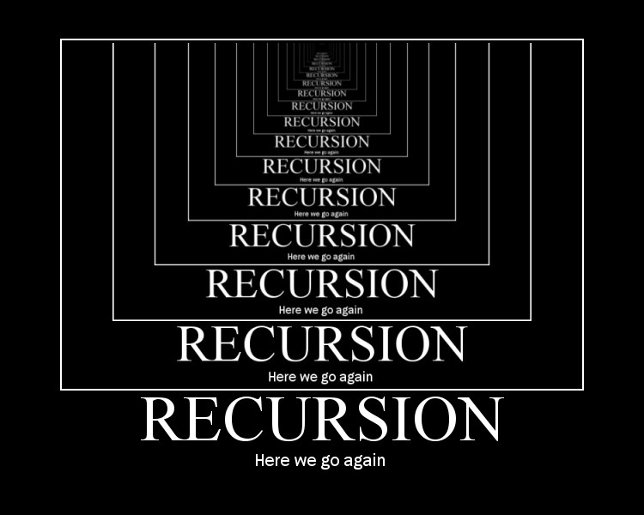
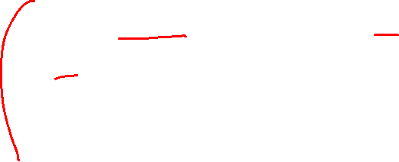
An aside on implementation
A visitor can call another visitor!
Farm example:
Use a visitor to view all food bins to set their amounts, BUT at each bin you need to know which animals are adjacent to it

Slide 32
Where and when

Slide 33

Near “must have” rules
If you have the following, you should probably use a Visitor
There are many distinct, and unrelated operations
There are multiple types
The operation is type specific

Slide 34
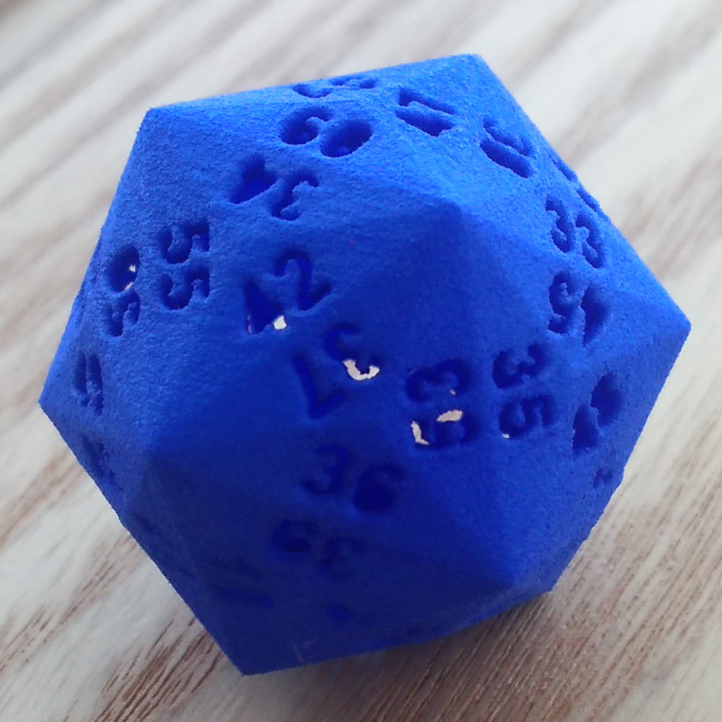

More details
There are many distinct, and unrelated operations…
No operation, then we have structs.
With many unrelated operations, we can get class bloat which "pollutes" the classes with these operations.

Slide 35

More details
There are multiple types…
AKA child classes
Without this, a regular manager often will do the job better

Slide 36
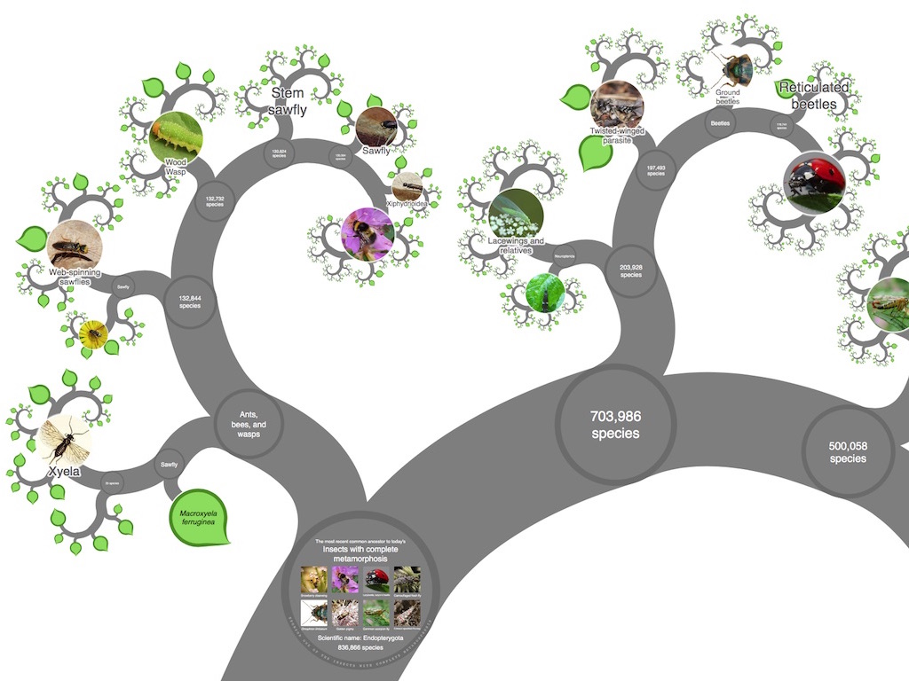

More details
The operation is type specific…
If it is not type specific, then inheritance should be sufficient

Slide 37
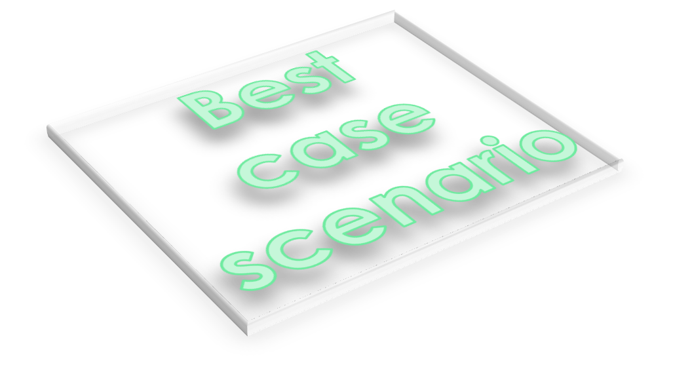
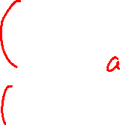
More details
Visitors are best when the classes defining the object structure rarely change, but you often need to define new operations over that structure.
Simulations (varying types of date to pull) and video games (interaction) come to mind…

Slide 38
Common usage
Again, a pattern is JUST a pattern
It’s a starting point.
Does the accept function need to be abstract?
How about an interface?
Do we have to define all accept functions?

Slide 39

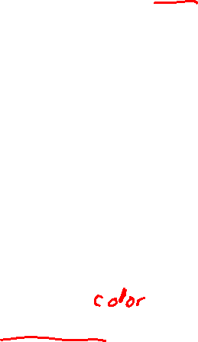
Common Variations
Add a default visit function (called from the other visits inside the interface).
This can be useful if you have operations to apply to all but one or two classes.
A visitor need additional information to work
Add member variables and use the constructor or settings to initialize it

Slide 40
(Bad) Alternatives

Slide 41

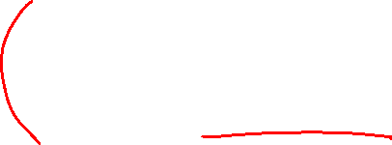
Use instanceof (or similar)
Could I write a static function with a giant switch with “instance of”?
Technically yes, you could. BUT this is considered bad practice in MANY cases.
Plus, let’s see what happens after we apply the SOLID principles…

Slide 42
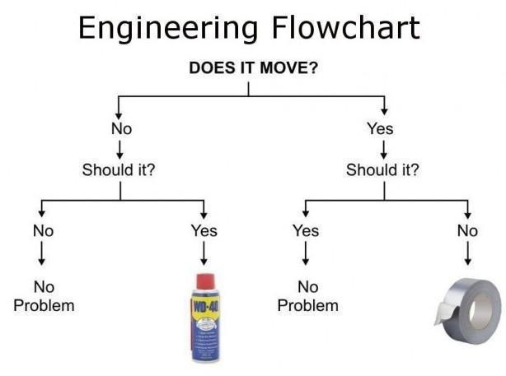
Use instanceof (or similar)
First…
Where should this giant block go?
Reminder: those that know, do!
The derived classes doesn’t work…
The parent class doesn’t work…
The manager manages the collection…OK, let’s try there

Slide 43

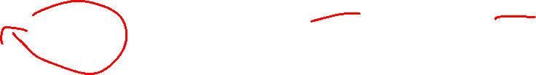
Use instanceof (or similar)
Oh wait…that breaks the O in SOLID…
Every time I need a new operation, I need to reopen the manager…
Solution?
Put it in its own class! This means you still send each element to this class…
Bonus: the intermediate result goes in this class as well, and we avoid “code bloat”

Slide 44
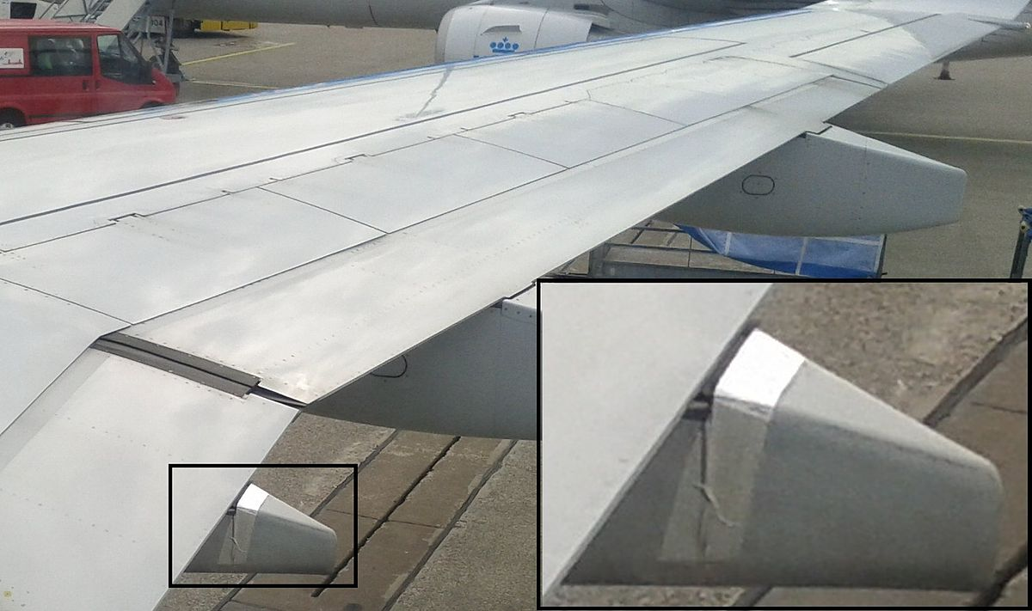
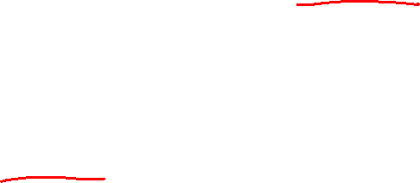
Use instanceof (or similar)
Oh wait…that breaks the I in SOLID…
We should rely on interfaces (abstractions). Right now, the operation is “duct taped” to the class that has our giant if-else if block.
Solution?
Make an interface and derived the operation!
In this case, we only have one function which has the entire set of instances of’s

Slide 45

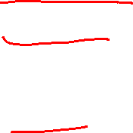
Use instanceof (or similar): NOPE!
Oh wait…good coding practice will have each else-if call a function to do it job, like so:
if obj.getType() ==“A”
doAsFunc((A)obj)
else if obj.getType() ==“B”
doBsFunc((B)obj)
else if obj.getType() ==“C”
doCsFunc((C)obj)
…
Hold on, doesn’t visitor go directly to the doXsFunc(…) with acceptX(…)?
Yes, yes it does.
In summary, you have two fewer function calls with the visitor pattern, and you haven’t changed the number of your classes!

Slide 46
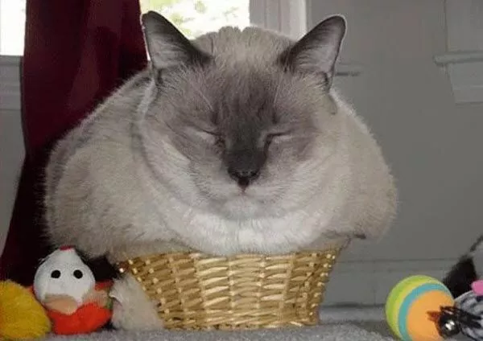
So, what does this mean
In general, if a function doesn’t “fit” in current classes…add another CLASS!
Most patterns simply logic their way trough common program needs while maintaining SOLID, and finds the set of classes needed to do it.

Slide 47
Practice

Slide 48
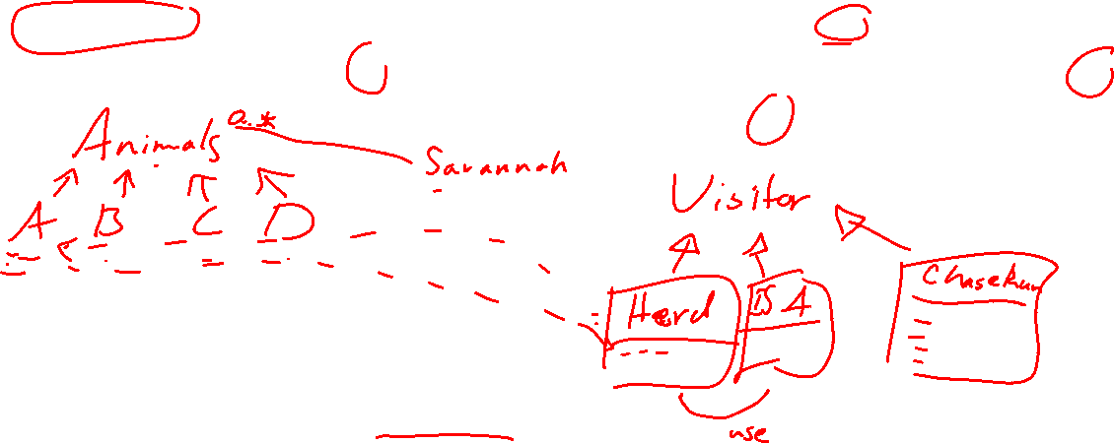
Practice
You have a savannah simulator with many types of animals. You want herbivores of type A to herd. And predators type B to chase herbivores of types A, C, and run from type D.
What are our classes?
What are our visitors?
What is our sequence diagram?

